Slide 1
Forecasting Analysis
Brent Crude Oil Price Prediction
Group no.5 Members
Sujit kumar Bahadur Yadav
Mr.Pasala Nuthan Vara Kishore
Mr. Kamal Raja Kondeti
Ms. Sushmitha. N
Mr. Yuvraj Ashok Mandlik
Ms. Sushma F Patil
Mentors
Siri .K.S

Slide 2
Introduction
Brent Crude oil
Dataset Details
Project Objective
The objective of this analysis is to gain insights into the historical trends and patterns of Brent Crude Oil prices and to develop a robust forecasting model to predict future oil prices.
Brent Crude Oil is a major trading classification of sweet light crude oil that serves as a major benchmark price for purchases worldwide. It is one of several crude oils used as a reference in the international oil market
Product: Brent Crude Oil
Dataset count: approx. 9500
Dataset Format: CSV file

Slide 3
Agenda
Data Loading and Preprocessing
Visualization and Exploratory Data Analysis (EDA)
Stationarity Check
Stationarity Improvement Techniques
Upsampling and Interpolation
Time Series Decomposition
Autocorrelation Function (ACF) and Partial Autocorrelation Function (PACF) Plots
Modeling
ARIMA Model
Neural Network Models (CNN, LSTM, GRU)
Prediction Visualization
EDA

Slide 4
Data Loading and Preprocessing:
Libraries like pandas, numpy, matplotlib, seaborn, and others are imported for data manipulation, analysis, and visualization.
Time series data from the 'DCOILBRENTEU.csv' file is loaded into a Pandas DataFrame.
Initial data exploration and cleaning are performed:
- Renaming columns, converting data types, handling missing values, and setting the 'date' column as the index.
- Data is checked for duplicates, and missing values are handled by imputing them with the mean of each month.

Slide 5
Visualization and Exploratory Data Analysis (EDA):
Time series plot of 'DCOILBRENTEU' over time is created.
Rolling mean plots for different window sizes (2, 4, 6, 8) are visualized to observe trends.
Histogram and density plot of 'DCOILBRENTEU' values are created.
Lag plot and autocorrelation plot are generated for time series analysis

Slide 6
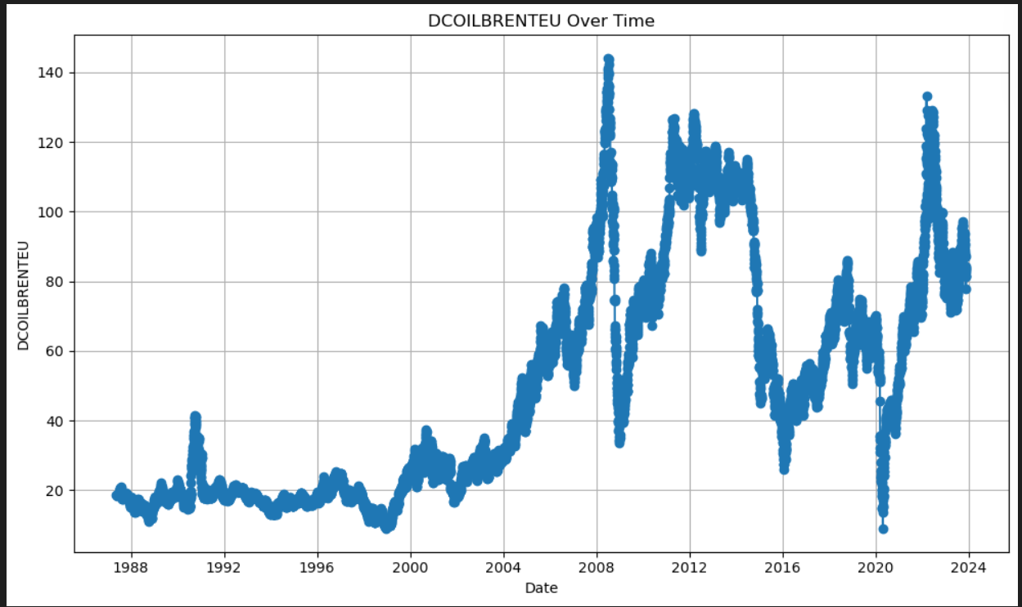
Time series plot of 'DCOILBRENTEU' over time

Slide 7
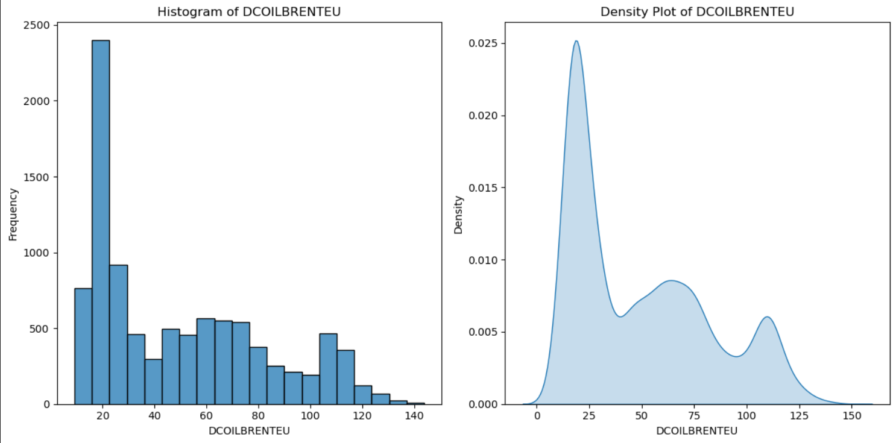

Slide 8
Stationarity Check:
Augmented Dickey-Fuller (ADF) test is performed to check for stationarity in the time series data. The test result includes the ADF statistic, p-value, and critical values.
-ADF Statistic: -2.116525385914011
-p-value: 0.23792178843646417
-Critical Values:
1%: -3.431039477205773
5%: -2.8618447060967434
10%: -2.566932189953556
The p-value resulting from the Augmented Dickey-Fuller (ADF) test is 0.2379. When comparing this to common significance levels like 0.05, the p-value is higher, indicating that there isn't enough evidence to reject the null hypothesis.
This suggests that the data might not be stationary. In non-stationary data, you typically see trends, seasonality, or other patterns that affect the mean or variance across time. You might consider further analysis or transformations to make the data stationary if needed for time series modeling or analysis.

Slide 9
Stationarity Improvement Techniques:
Two methods are applied to make the time series stationary:
Differencing: Creating a new column 'Stationary_Value' with differenced values.
Log Transformation: Applying a logarithmic transformation to the 'DCOILBRENTEU' values.

Slide 10
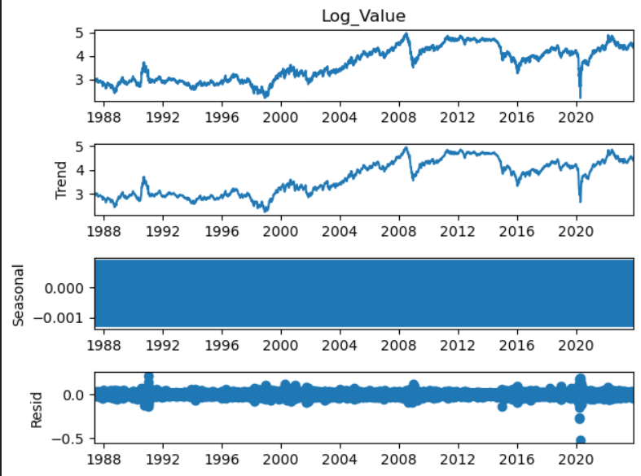
Time Series Decomposition:
Seasonal decomposition of time series using both additive and multiplicative models is performed, and the components (trend, seasonal, residual) are visualized

Slide 11
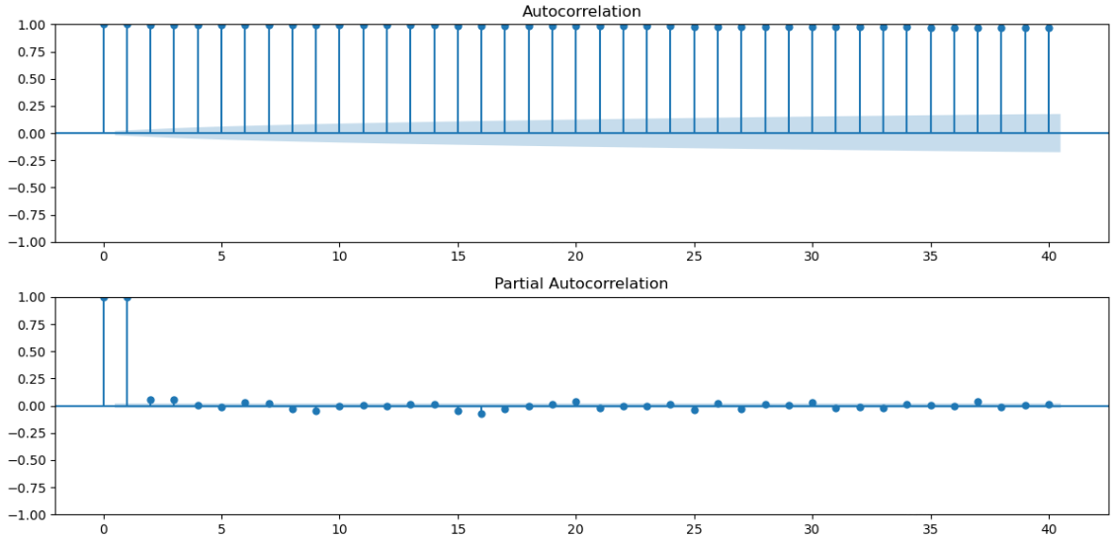
Autocorrelation Function (ACF) and Partial Autocorrelation Function (PACF) Plots:
ACF and PACF plots are generated to identify the order of autoregressive (AR) and moving average (MA) components for time series modeling.

Slide 12
Modeling:
Several time series forecasting models are applied, including Simple Exponential Smoothing, Holt's Exponential Smoothing, Holt-Winters' Exponential Smoothing, ARIMA, and neural network models (CNN, LSTM, GRU).
The models are trained, validated, and evaluated using metrics such as Mean Squared Error (MSE) and Mean Absolute Percentage Error (MAPE).

Slide 13
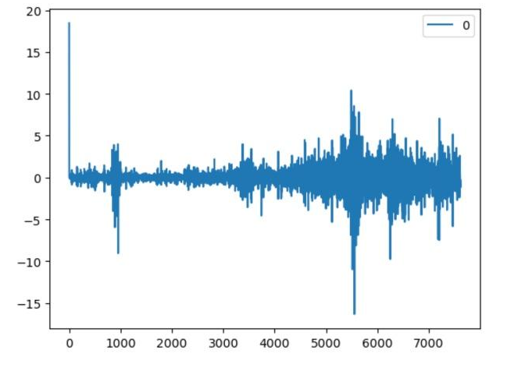

Slide 14
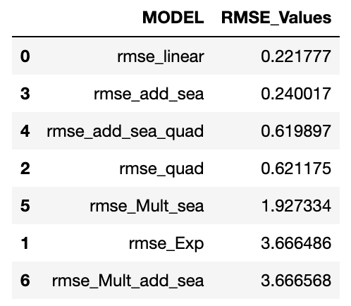
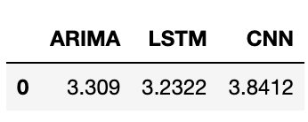
Comparison of Models:
The RMSE values for different models are compared using bar and line plots, and the best-performing model is identified based on the lowest RMSE.

Slide 15
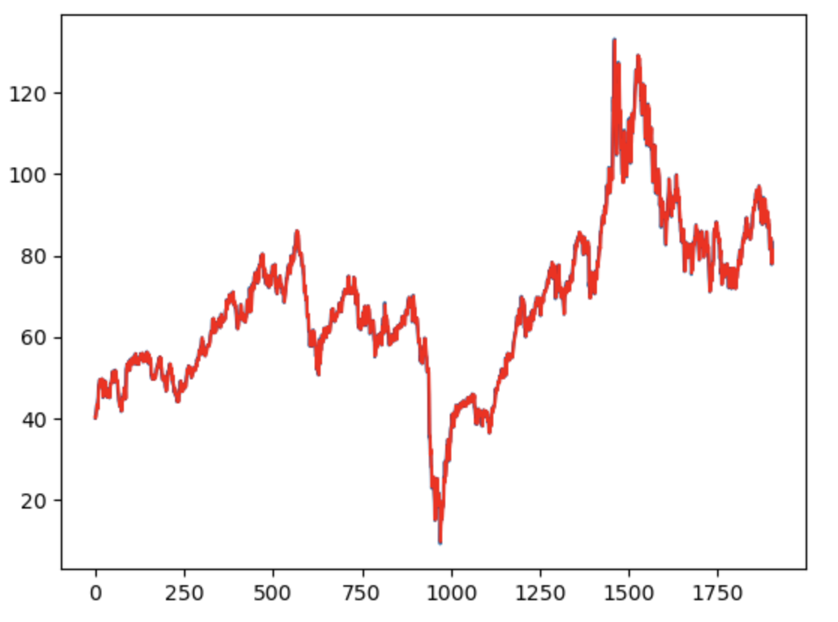
Chosen model
We have chosen ARIMA because of its MSE value which is 3.309.
It is the best suited model for the forecasting of brent crude oil prices

Slide 16
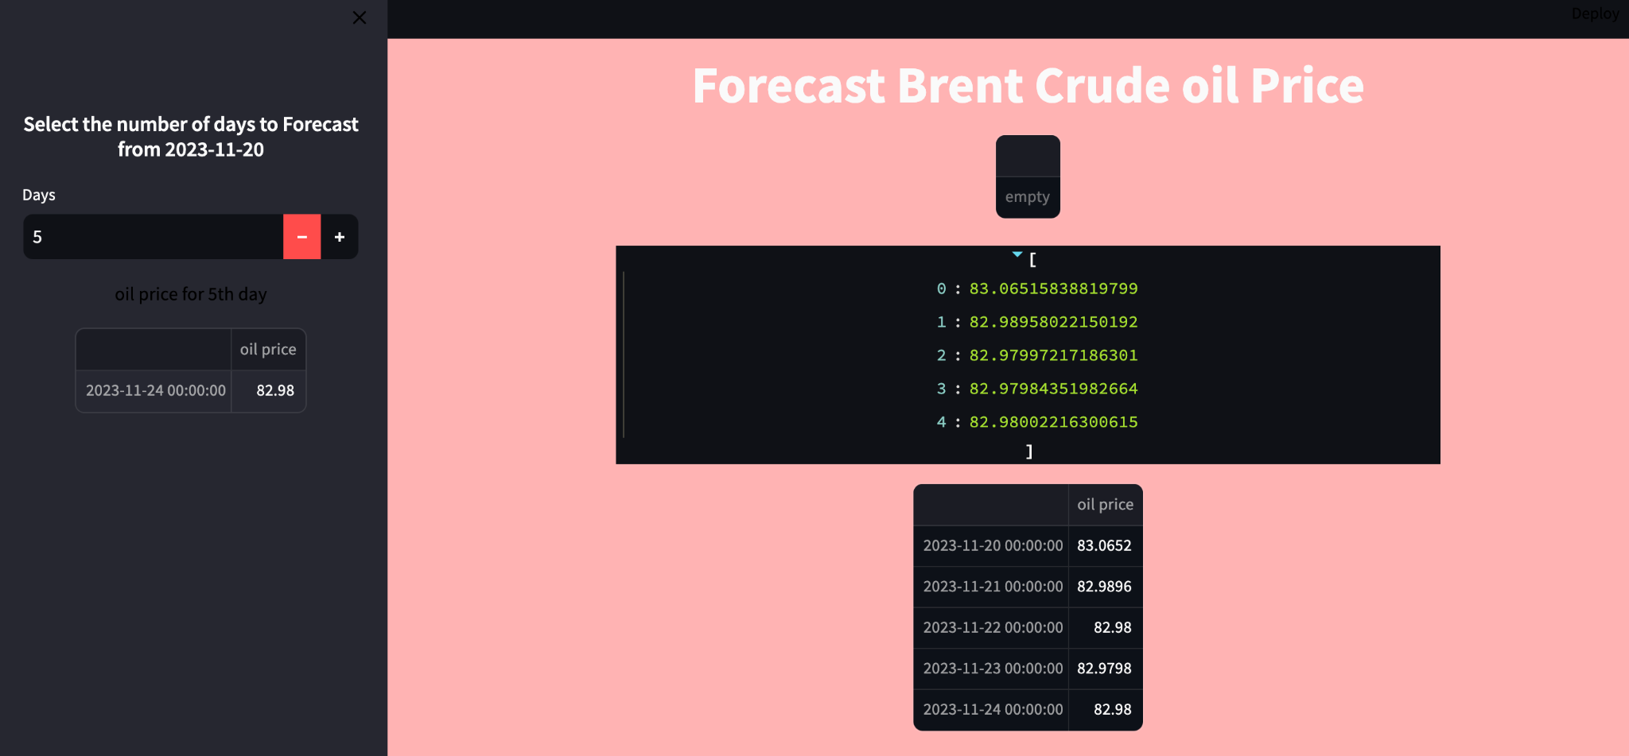
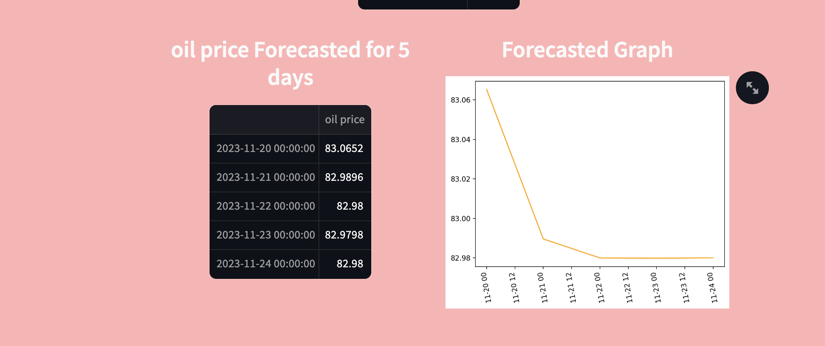
Deployment

